Slide 1
MILESTONE 4
Road Accident
Transportation
Security Risk Assessment • Predictive Threat Analytics • Executive Dashboards • Forecasting & Alerting
TEAM MEMBERS
1
2
3
4
Pavana R
Rhutuja Kshirsagar
Shaista Sultana
Subasri N

Slide 2
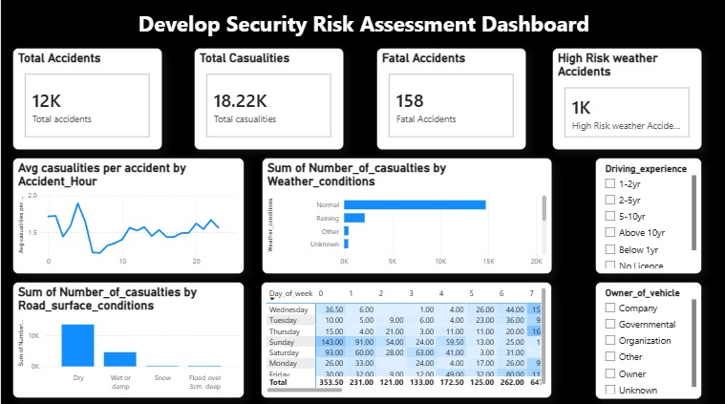
DASHBOARD 01
Develop Security Risk Assessment Dashboard

Slide 3
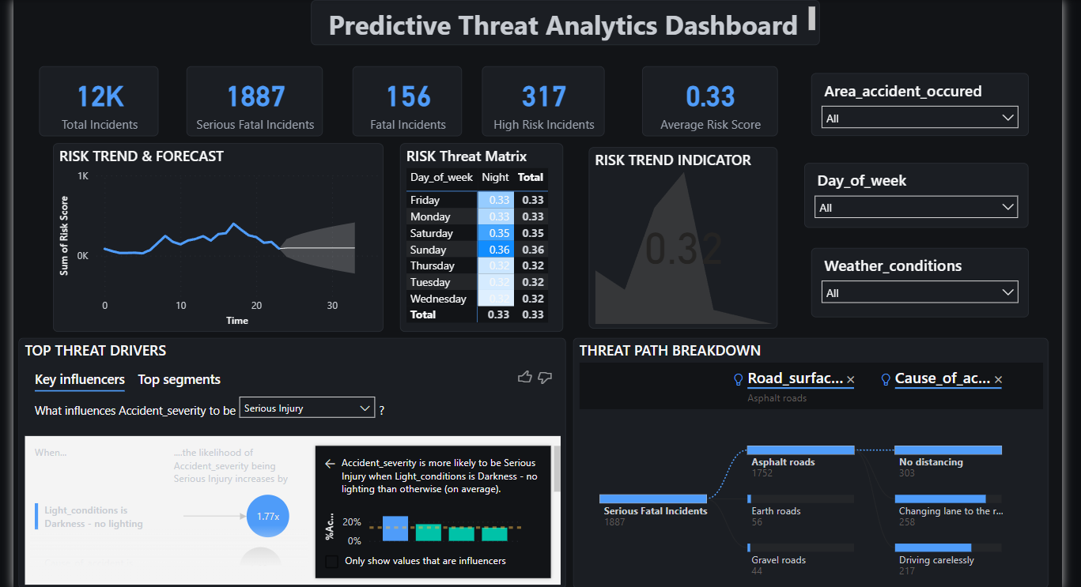
DASHBOARD 02
Implement Predictive Threat Analytics

Slide 4
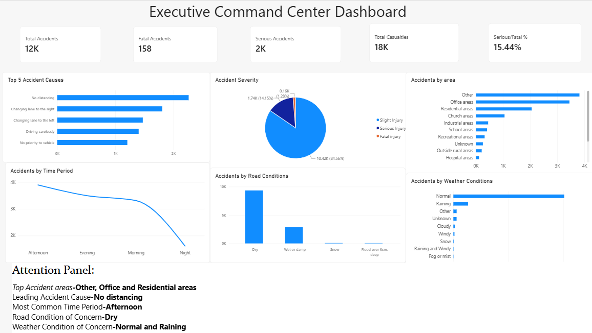
DASHBOARD 03
Build Executive Command-Center Dashboards

Slide 5
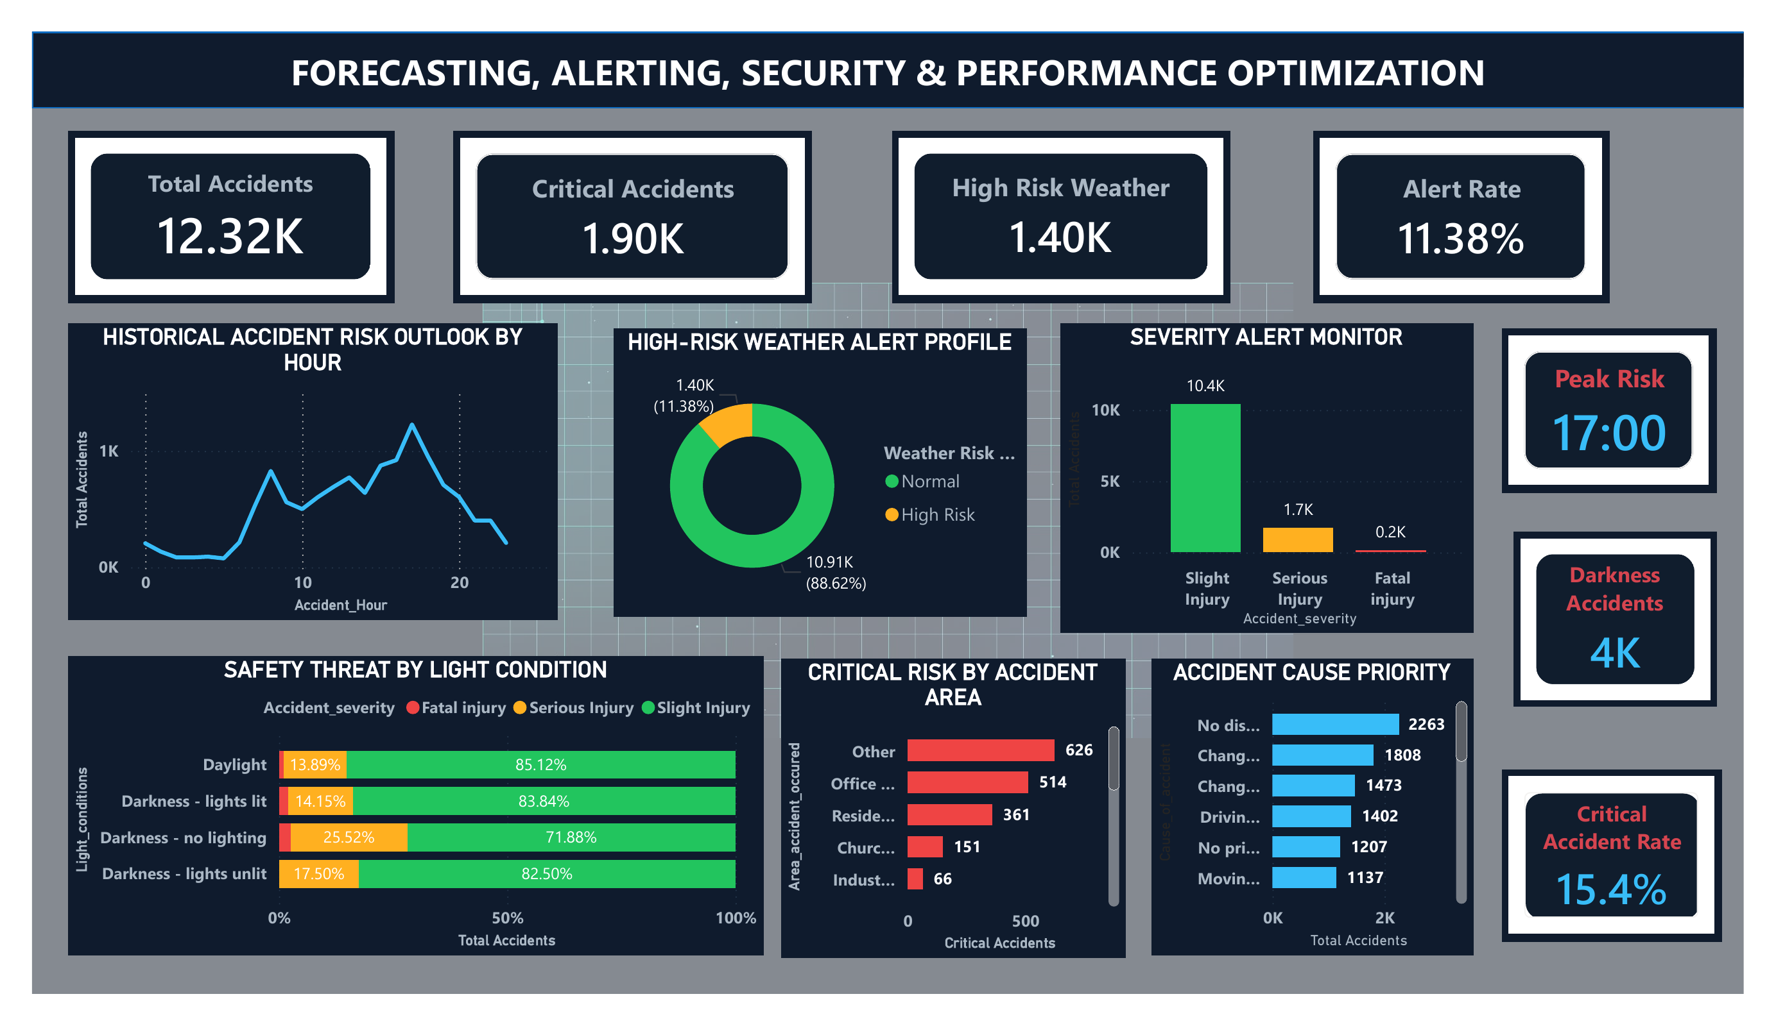
DASHBOARD 04
Finalize Forecasting, Alerting, Security & Performance Optimization

Slide 6
CONCLUSION
Turning Accident Data into Actionable Safety Intelligence
Across all four dashboards, the project delivers an end-to-end view of road accident risk — from raw incident data to predictive threat scoring.
Key risk drivers consistently point to darkness without lighting, weekend timing, and lack of distancing as the strongest predictors of severe outcomes.
The Executive Command Center and Forecasting dashboards translate these findings into a 15.4% critical accident rate and an 11.38% alert rate, giving decision-makers a clear, monitorable baseline.
Together, these dashboards equip stakeholders to prioritize interventions by location, time of day, and weather condition — improving both response speed and long-term road safety planning.

Slide 7
Thank You
Milestone 4 — Road Accident Transportation
Pavana R • Rhutuja Kshirsagar • Shaista Sultana • Subasri N

